Slide 1

Organized by: Logic Masters India
Sudoku Champs
National Junior Sudoku Championship

Slide 2


About World Puzzle Federation & Logic Masters India
World Puzzle Federation (WPF) is an international organization dedicated to puzzles.
The WPF brings together puzzlers from all over the world for the annual World Puzzle Championship (WPC) and the World Sudoku Championship (WSC), now jointly called as WSPC.
National teams are determined by affiliates of the WPF.
Logic Masters India (LMI) is the official Indian representative of WPF.
LMI aims to find and hone talent from the deep ends of India and nurture the dream to see India finish at the podium and become a fixture at the top end of the World rankings. Towards this goal, we organize numerous puzzle contests and activities.

Slide 3
Sudoku Champs
Sudoku Champs is an annual national junior sudoku championship organized by Logic Masters India (LMI). It has been organised in 2015, 2018 and 2024.
In 2024, more than 500 kids participated in the event across different age categories.
The contest was held in 6 major cities last year – Delhi, Mumbai, Chennai, Kolkata, Bangalore and Hyderabad. Additionally, LMI plans to add a few other cities for this year’s event.
Participation will be across 4 age categories – U10, U12, U15 and U18. The contest will be held in different cities from November – December 2025.
Sudoku Champs – City Rounds
(November-December 2025)
National Winners Announcement – December 2025

Slide 4
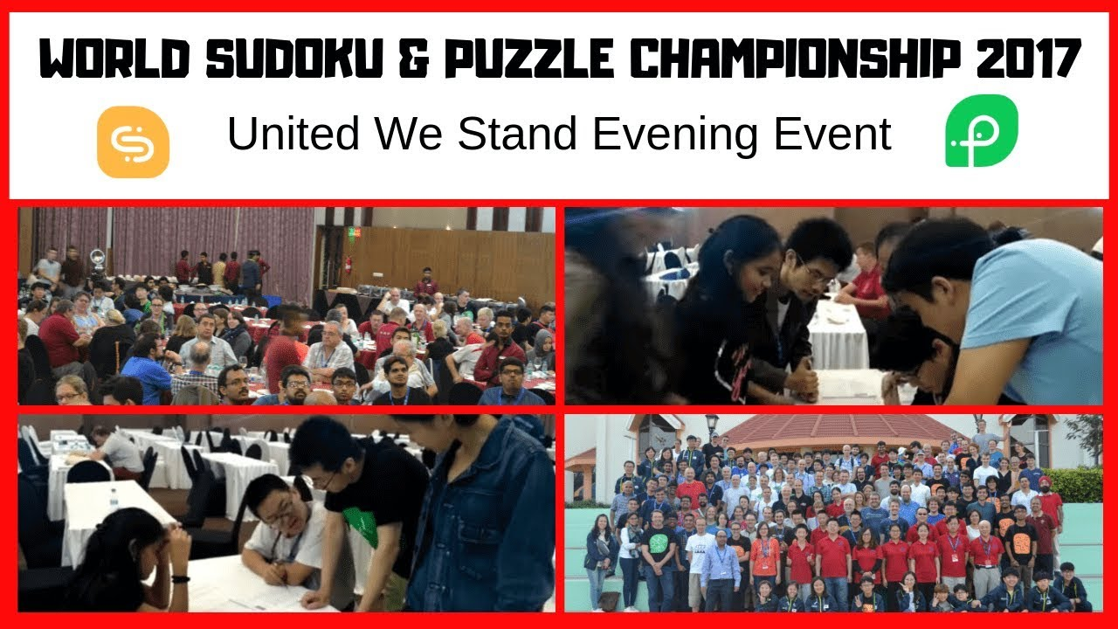
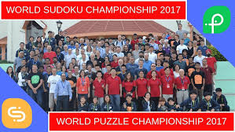
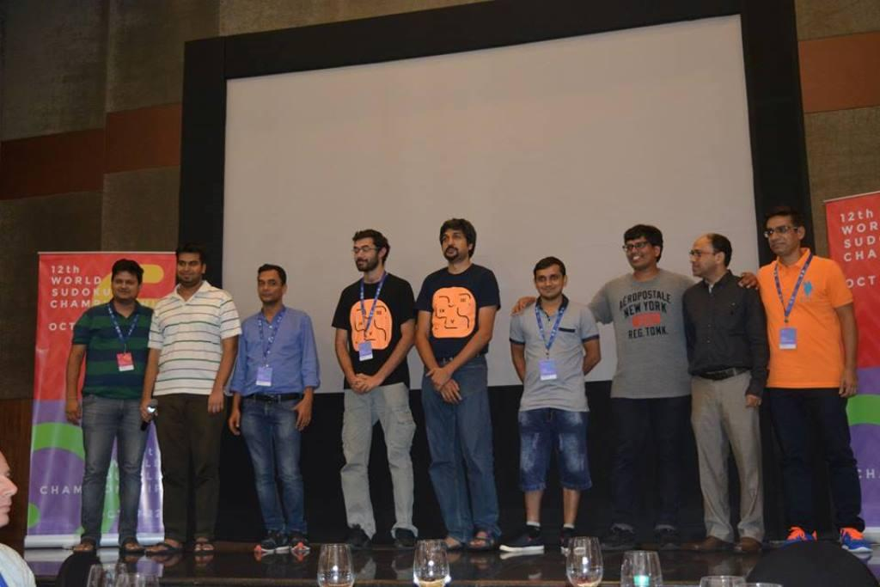
LMI Organising Experience:
WSPC 2008, Goa & WSPC 2017, Bangalore

Slide 5
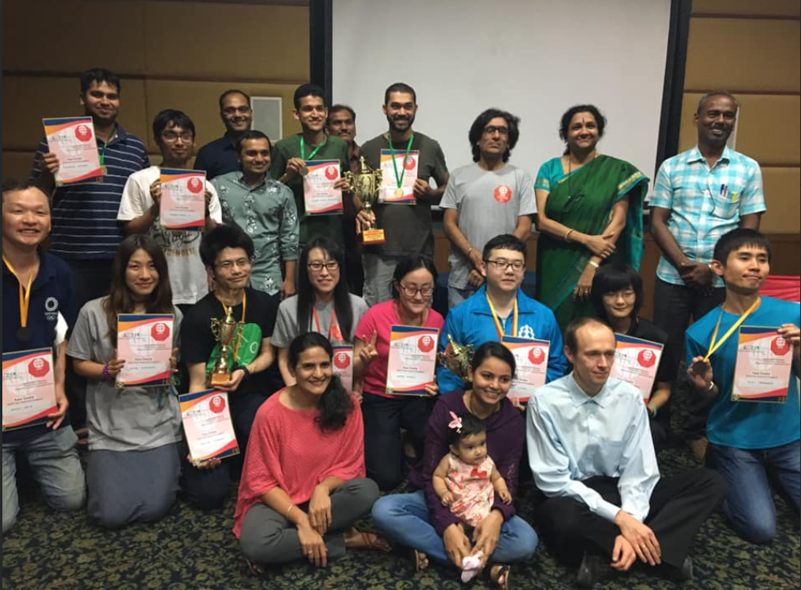
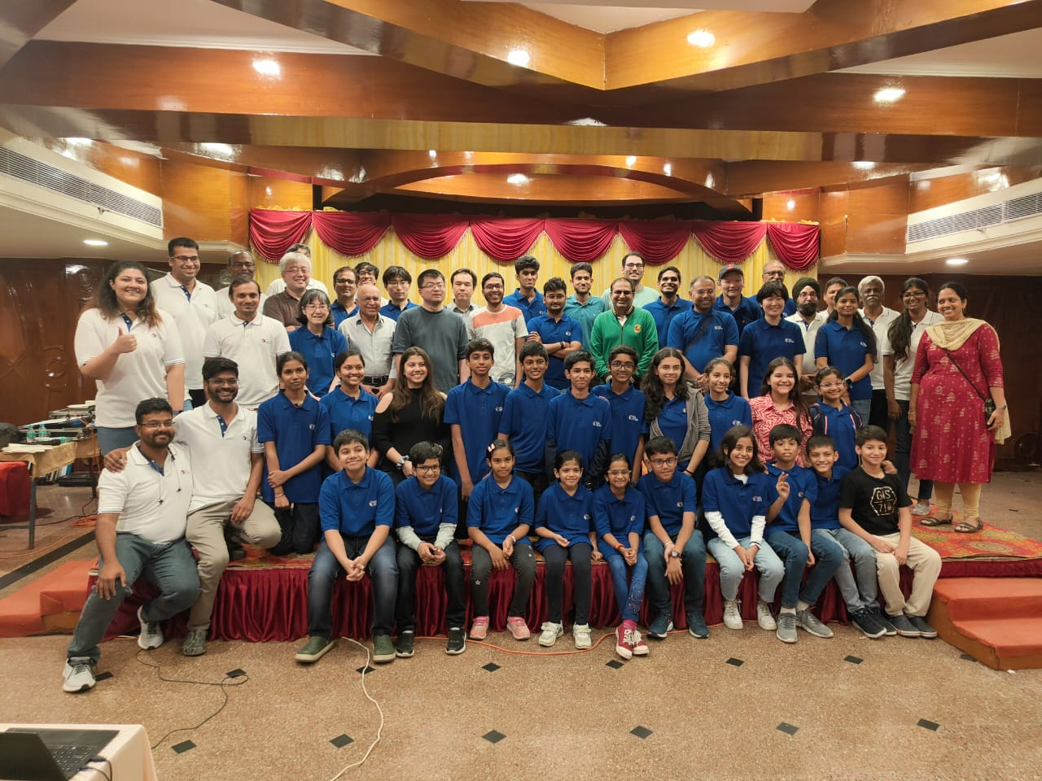
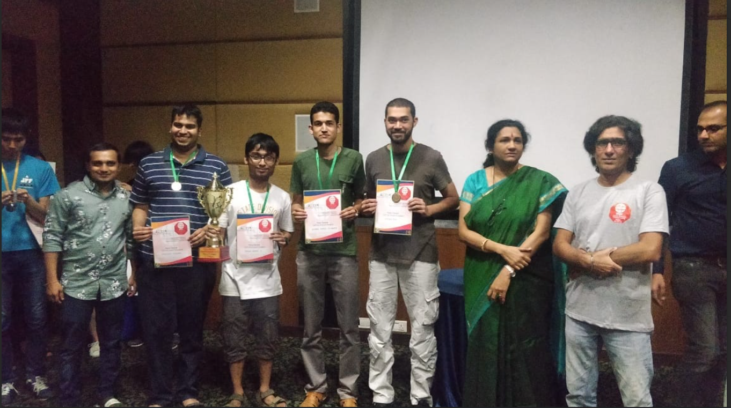
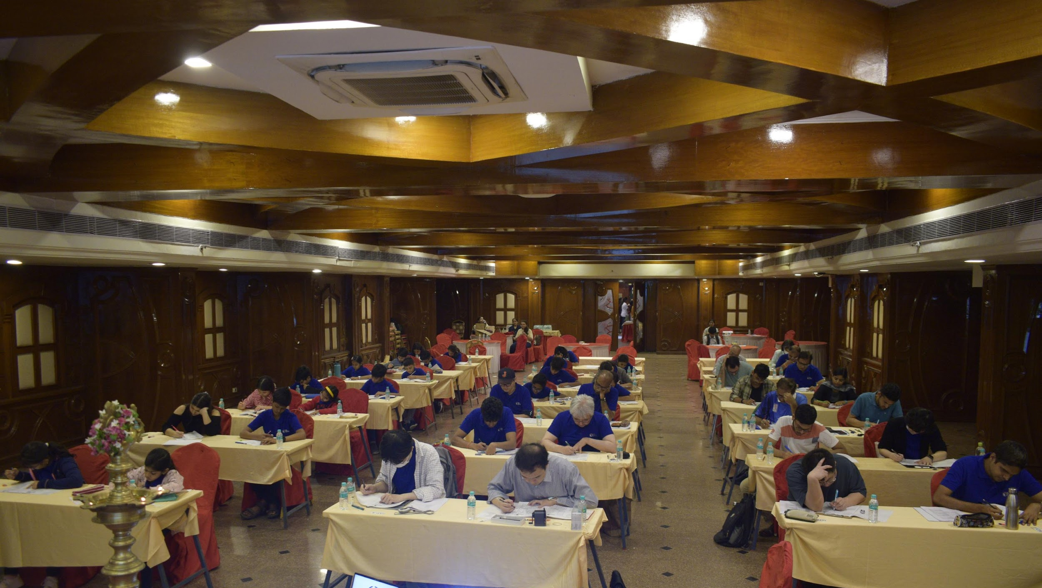
LMI Organising Experience:
Asian Sudoku Ch’ship 2020 and 2025

Slide 6
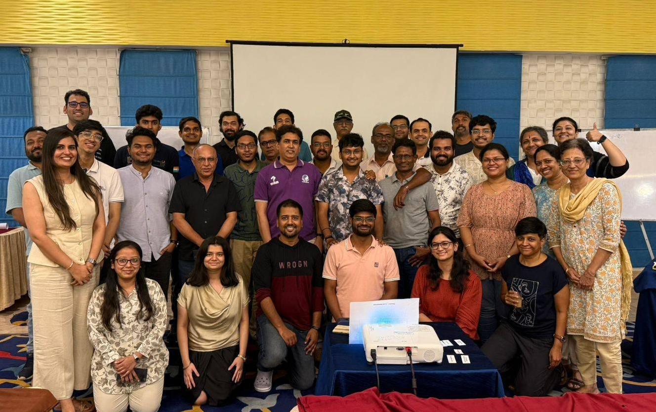
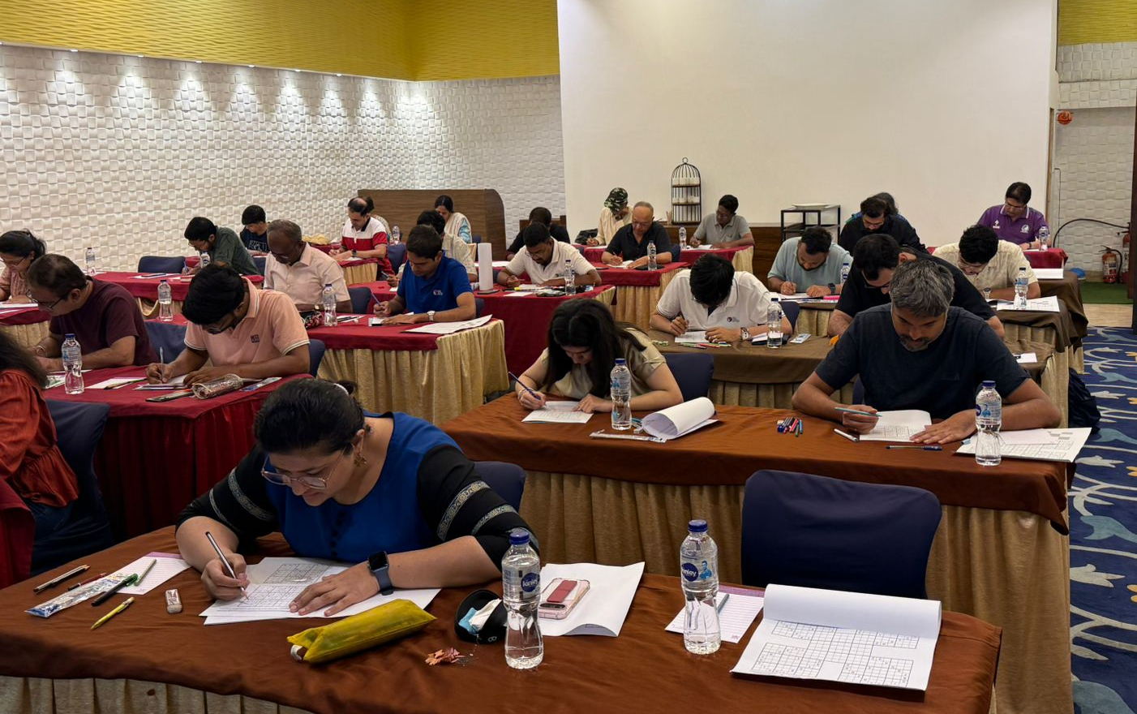
LMI Organising Experience:
Indian Sudoku & Puzzle Championship
(since 2011)

Slide 7
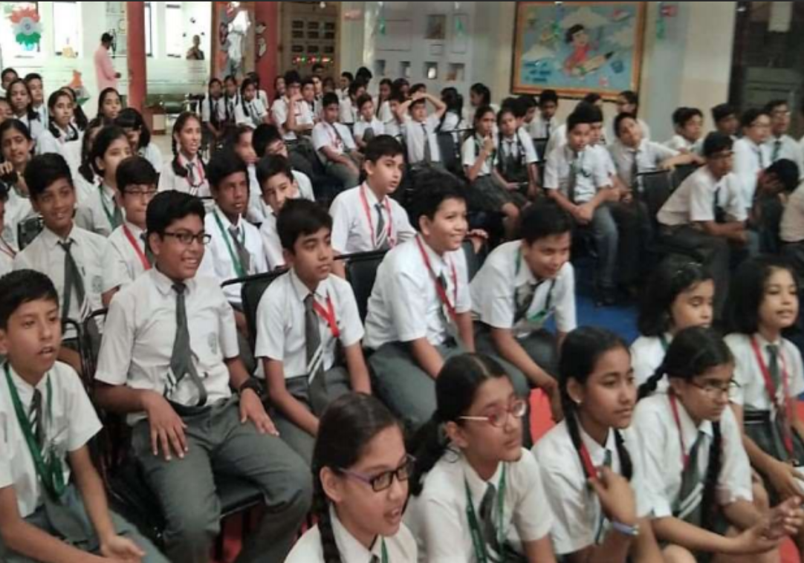
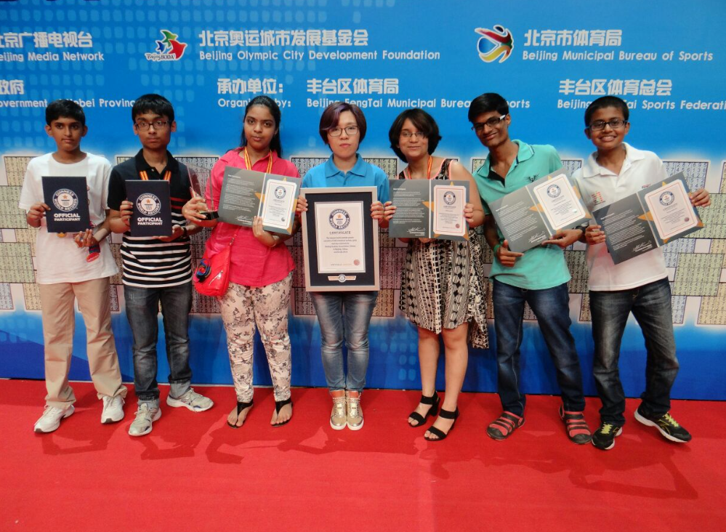
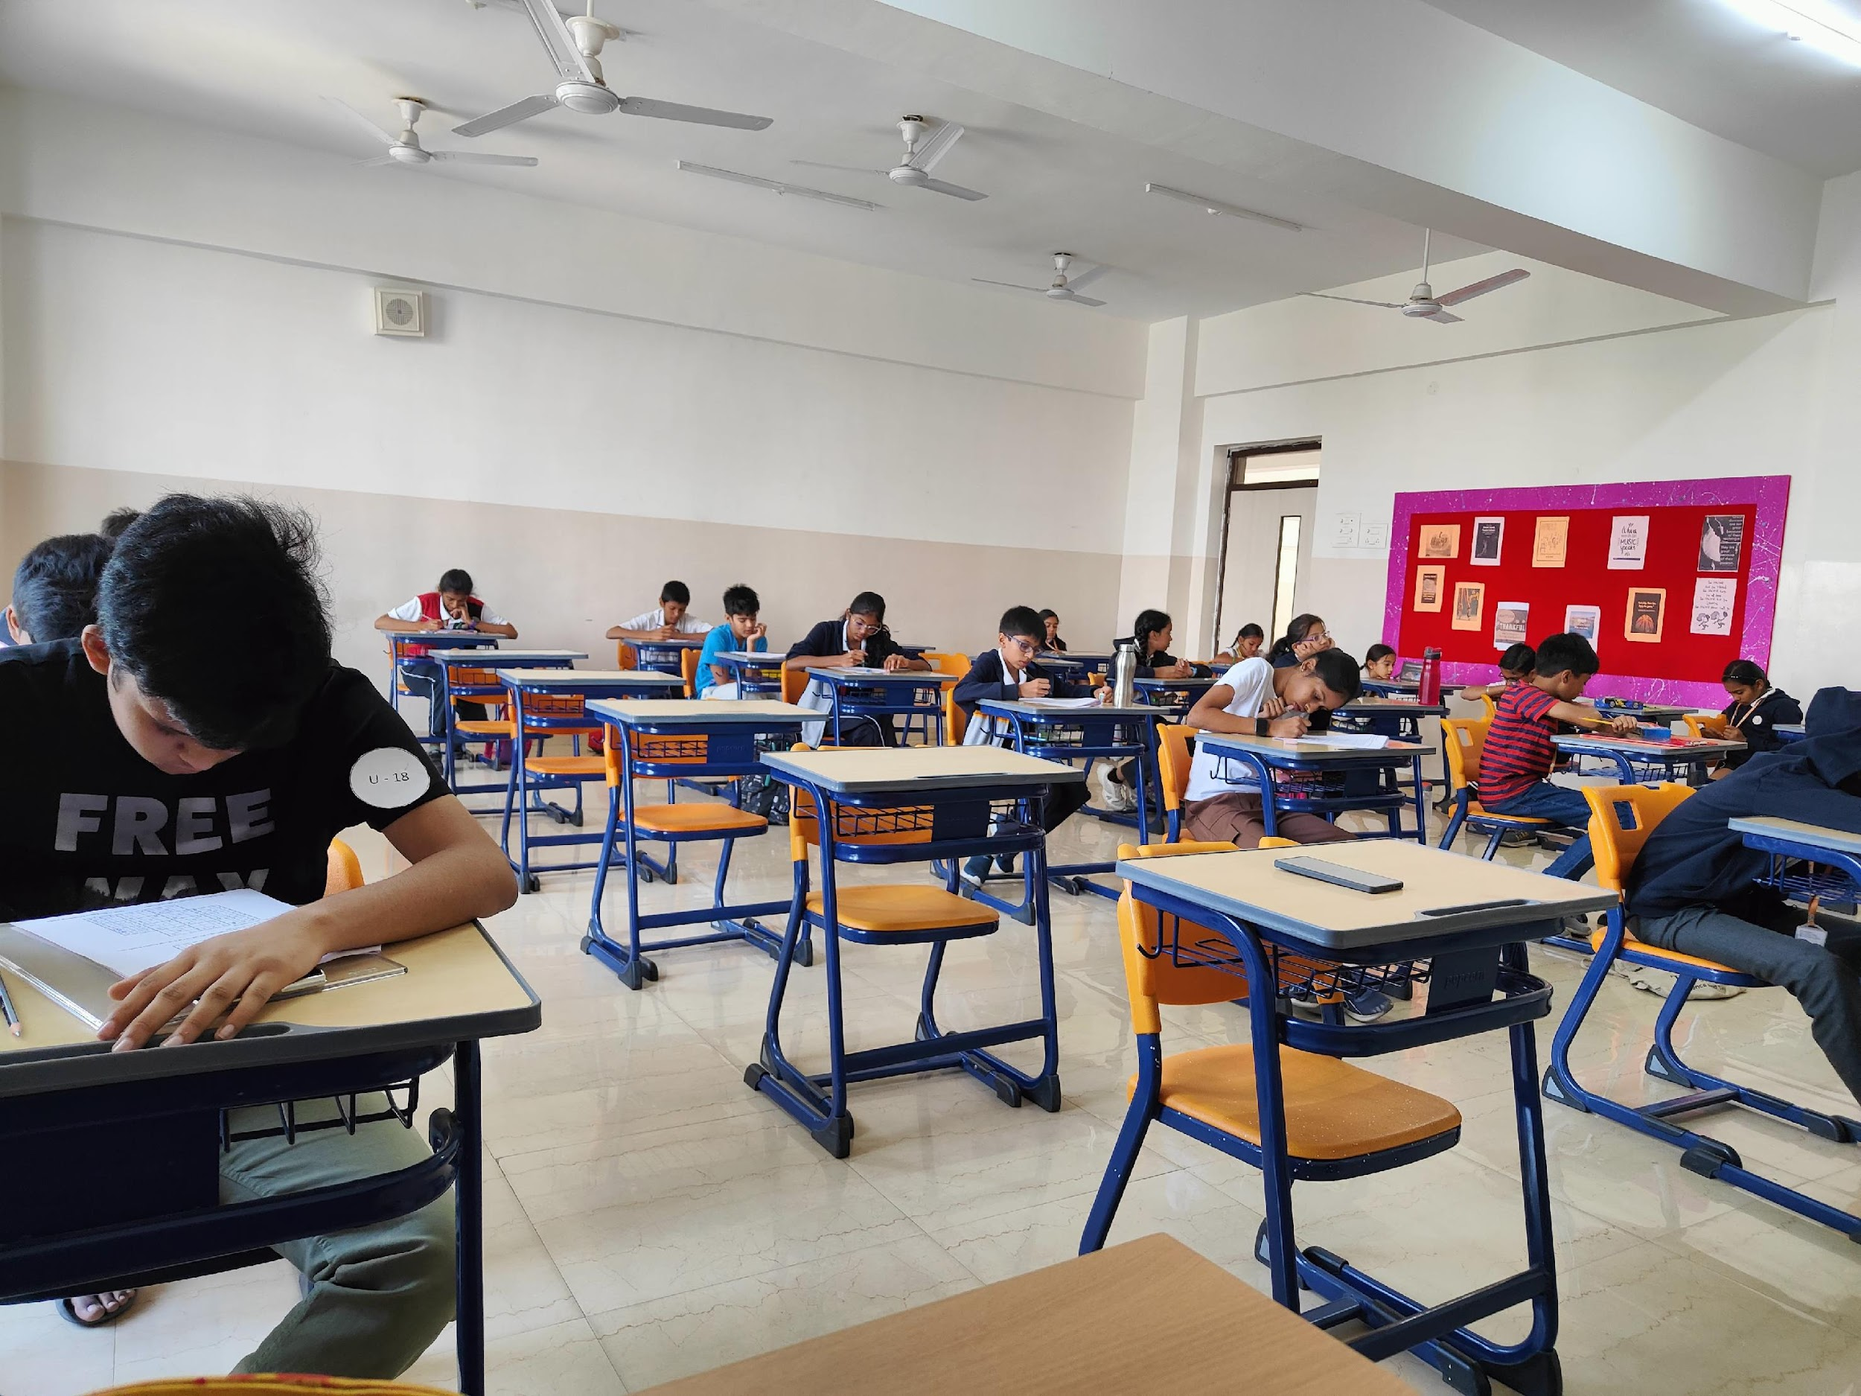
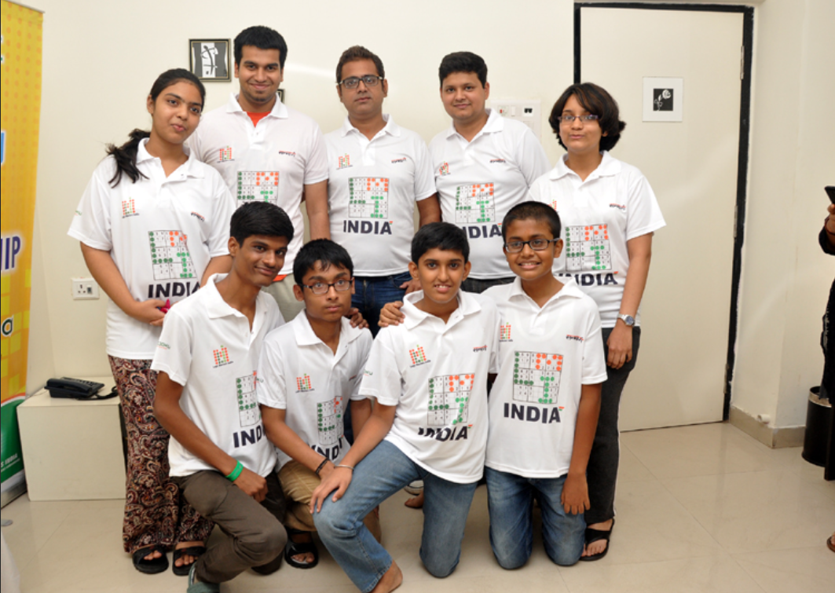
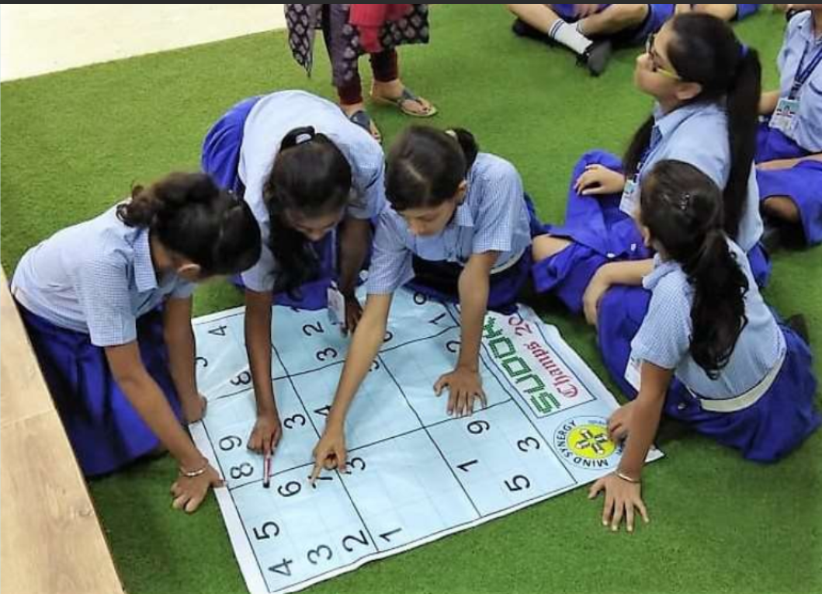
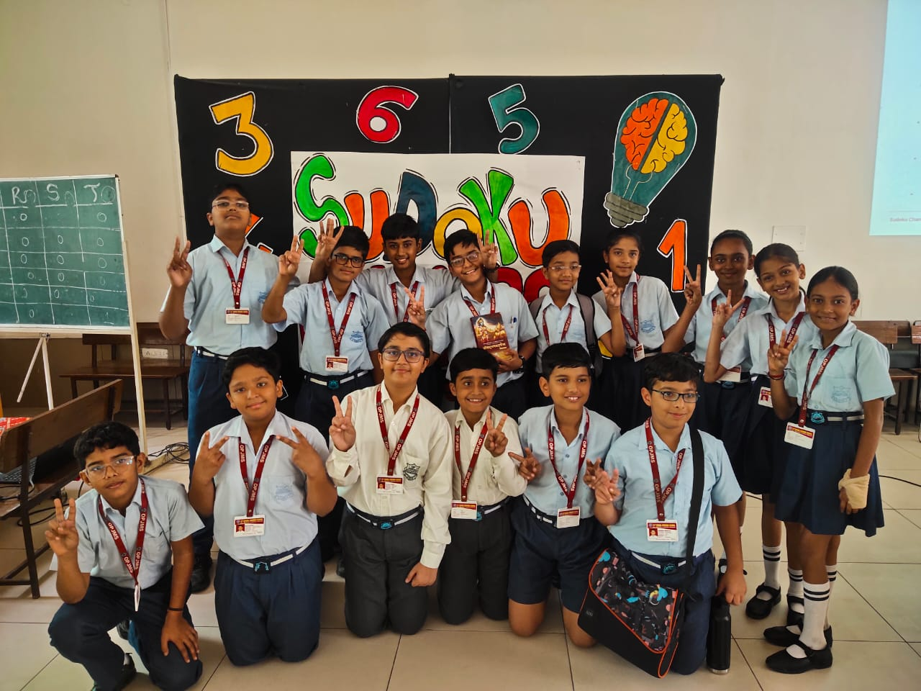
LMI Organising Experience:
Sudoku Champs 2015, 2018 and 2024

Slide 8
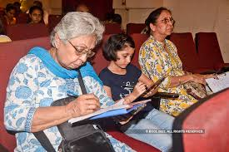
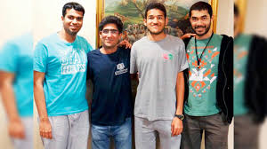

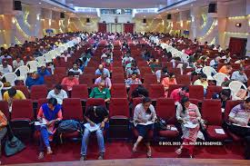
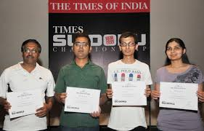
LMI Organising Experience:
Times Sudoku Championship

Slide 9
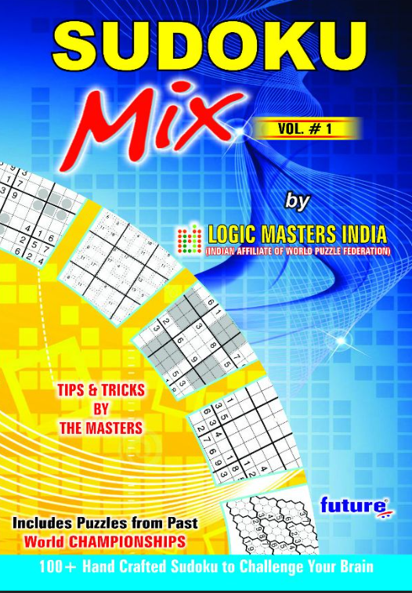
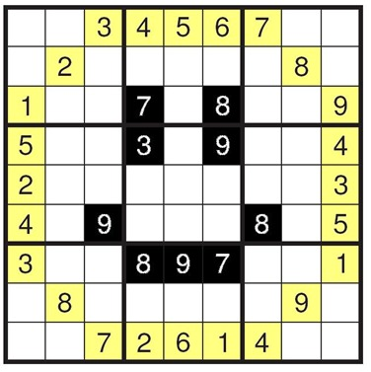
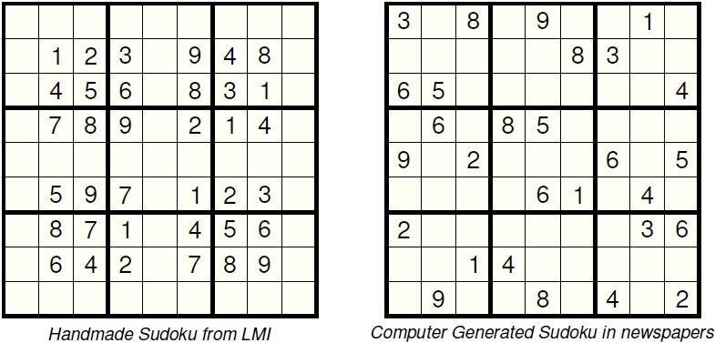
LMI Activities: Puzzle Creations
Promote and provide handcrafted puzzles (with themes and artistic patterns).
Platform for India’s best puzzle creators to showcase their talent.
Participants enjoy solving handmade sudokus more because they give the satisfaction of decoding the hidden logic of the creator
Sudoku with a Smiley Theme

Slide 10
SPONSORSHIP AND PARTNERSHIP OPPORTUNITIES

Slide 11
Why Sponsor/Partner
Sudoku, a logical number placement puzzle, is globally popular among millions of solvers. The outreach is via websites, mobile apps, newspapers and magazines.
Sudoku Champs is a National Event which would be covered in print and social media.
Sudoku Champs 2025 to have participation of 1000+ students from 30+ popular schools across 6+ cities.
Prominent coverage in LMI website (24000+ registered solvers worldwide)
LMI can be a content provider for any sponsors’ events/requirements. The team has world class puzzle solvers and creators with enormous experience.
Opportunities of future engagement in World Sudoku Championship, 2026 which will be held in India.

Slide 12



Past Collaborations and Partnerships
LMI had partnered with Times of India for several years in the last decade (2012-2019) for Regional and National Sudoku Events.
These events were organized across multiple metropolitan cities and received huge coverage in the newspaper.
LMI had collaborations with SportsConsult, BrainGames and Dainik Jagran

Slide 13
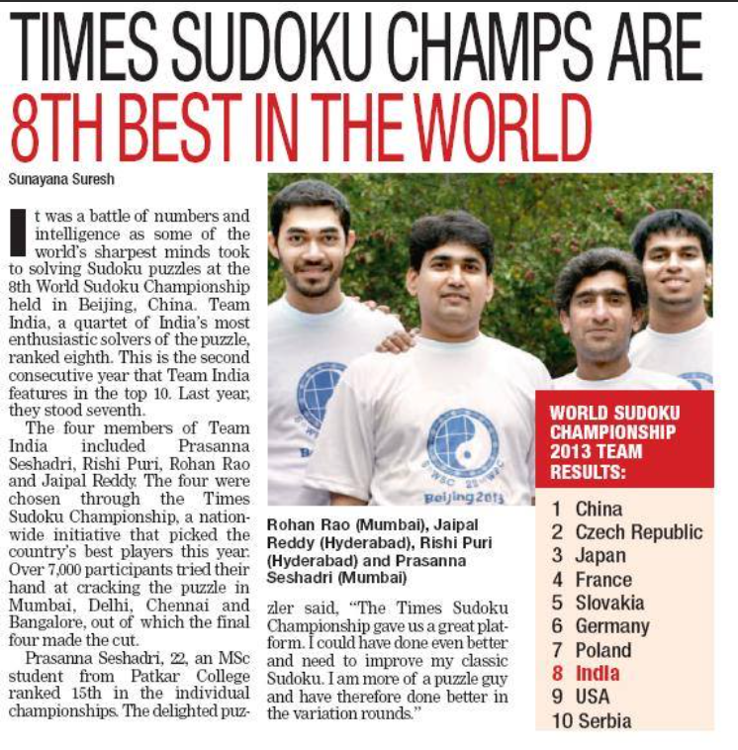
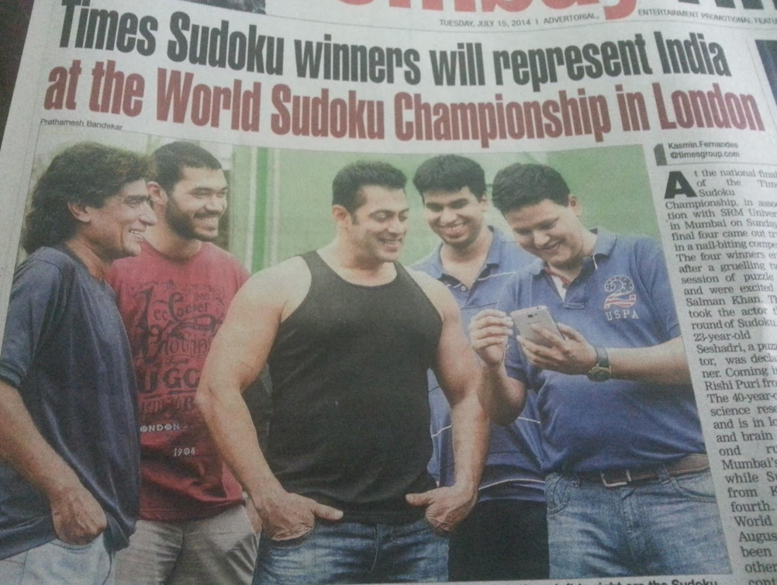
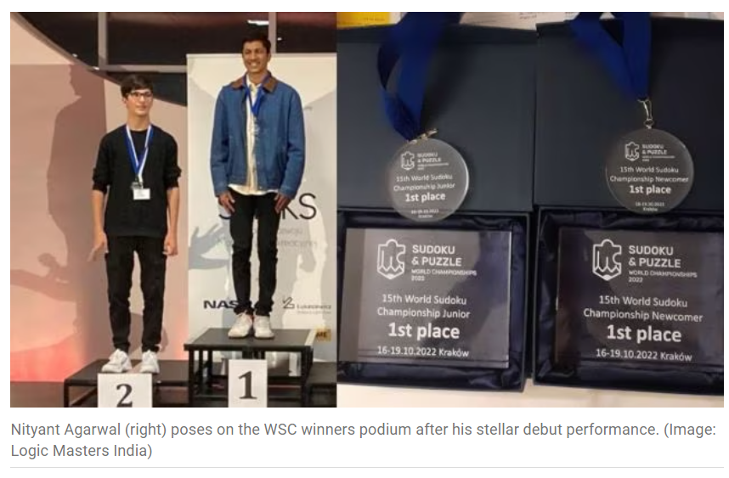
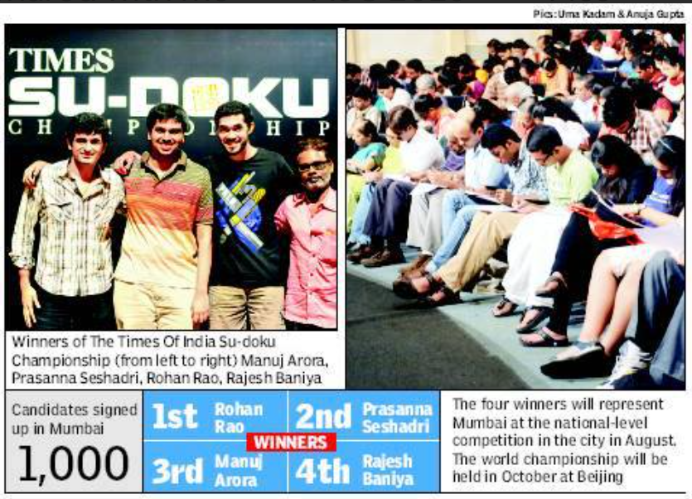
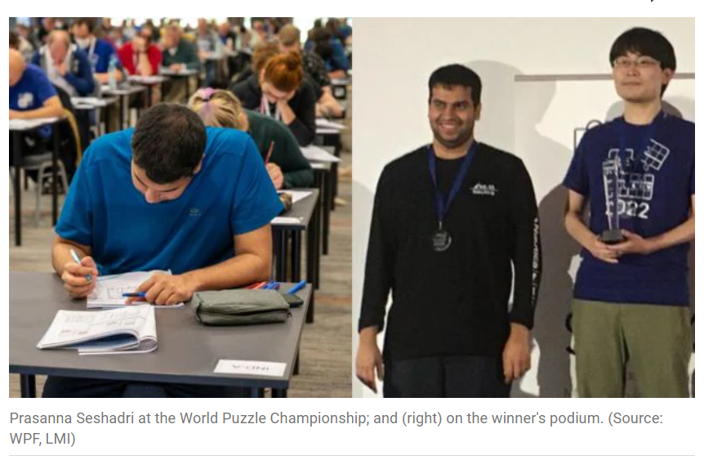
Articles in Newspapers
And Websites
Indian Express 2022

Slide 14
Sponsorship Entitlements
Sponsorship Category | Logo Integration with Event Logo | Logo on Trophies | Logo on Certificates | Promotional Banners at the event | Representatives may award prizes | Social Media Promotions | Themed Puzzles/Sudokus designed by authors for non-competitive events/Practice Content
Platinum | ✓ | ✓ | ✓ | ✓ | ✓ | ✓ | ✓
Gold | ✗ | ✗ | ✓ | ✓ | ✓ | ✓ | ✓
Silver | ✗ | ✗ | ✗ | ✗ | ✓ | ✓ | ✓
Bronze | ✗ | ✗ | ✗ | ✗ | ✗ | ✓ | ✓
Sponsorship Expectations:
Platinum: ₹ 50,000
Gold: ₹ 40,000
Silver: ₹ 30,000
Bronze: ₹ 20,000
*Non-Monetary contributions can be considered on a case to case basis.

Slide 15
For Further Details, please contact:
Logic Masters India (logicmasteradmin@gmail.com)
Sitanshu Sah (sitanshunov10@gmail.com, 9632422477)
Hemant Malani (hemantkr97@gmail.com, 8584837457)
Thank You!

